Slide 1


Notes:
Name
Speaking from Vancouver, ancestral homeland of Musqueam, Squamish and Tsleil Watuth People
10 years of non-profit experience most recently working in housing.
I grew up on the east coast of the US and moved to BC about 6 years ago.
Surprised to learn that there is a 5th season here, fire season.
When I was thinking of a topic for this project, Fires were in the news.

Slide 2
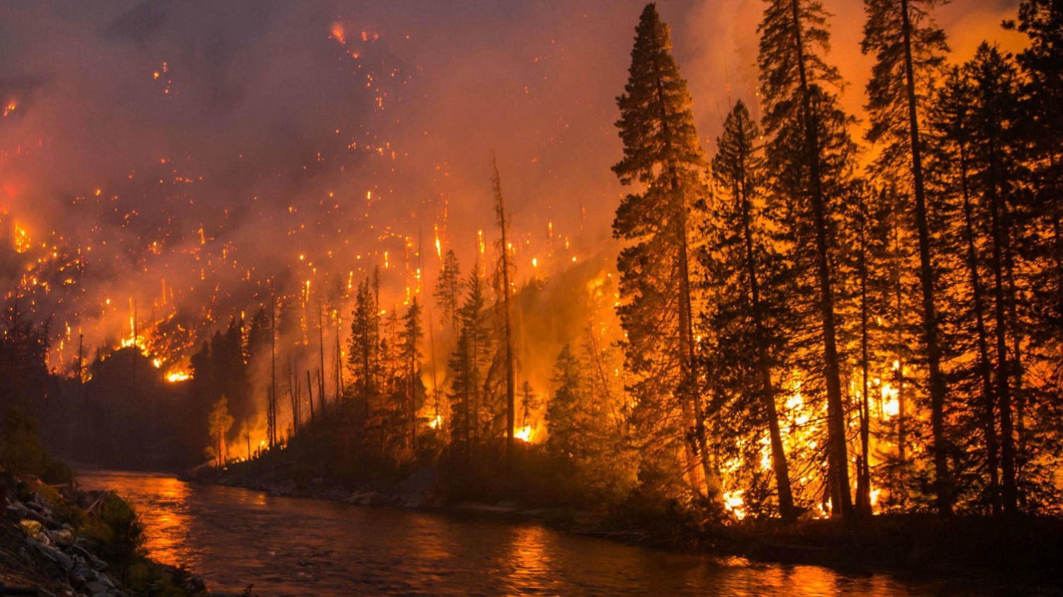
The Problem
Since 1990, wildfires consume on average about 2.5 million hectares a year¹
Fire suppression costs over the last decade in Canada have ranged from about $800 million to $1.5 billion a year²
Population growth means more people are living in areas that used to be wilderness
Fires can be a natural part of forest ecosystems
Notes:
The government spends hundreds of millions of $ on prevention and suppression
Growing population means more people are living closer to wilderness areas and feeling effects more
Fires can be a part of natural cycle in forest ecosystems, need to limit scope and mitigate risk. Live with a sustainable amount of fire.

Slide 3
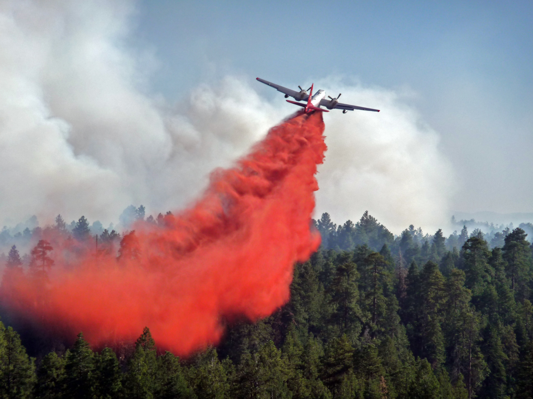
Use for Analysis and Forecasting
Resource Allocation
Prevention Efforts
Smart growth and development
Notes:
- Analysis of this data will give us a better understanding of wildfires. Can help with …

Slide 4
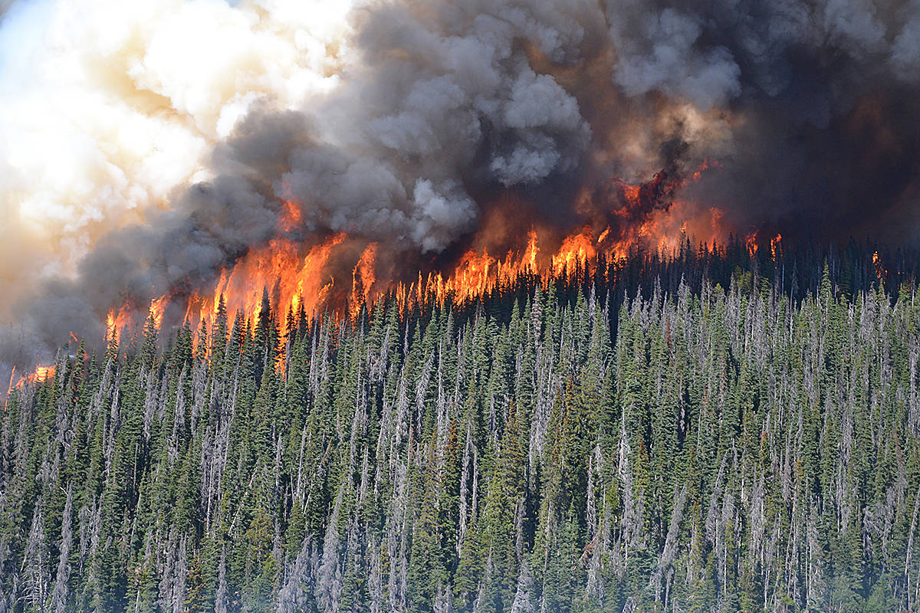
Data
Kaggle Wildfire Dataset
About 420,000 fires from 1946-2021
Weather from Open-Meteo
Temperature, wind, precipitation data for 2 weeks before each fire
Notes:
75 years of fire data.
Preceding 2 weeks of weather data for each fire into MongoDB

Slide 5
Process
EDA
Models
Tableau
Heavy focus on EDA
Collect insights into Tableau Dashboard
ML Modeling to Predict Fire Size
2-Phased Approach
Notes:
I wanted spend a lot of time digging into the data. Looking for trends and correlations.
Gather that analysis into an interactive tableau dashboard.
Finally, I attempted to build a ML model that could predict fire size.

Slide 6
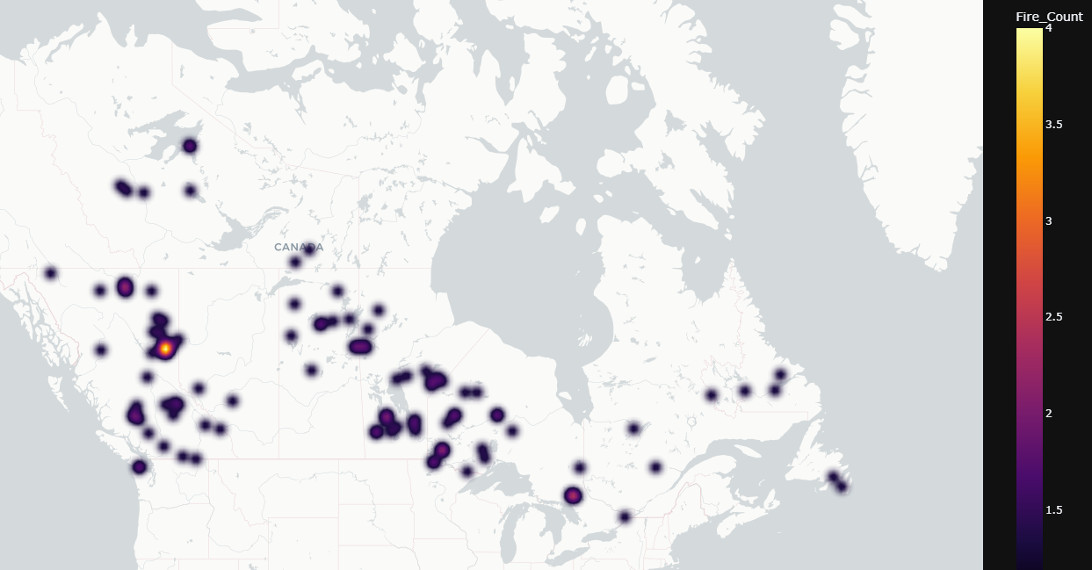
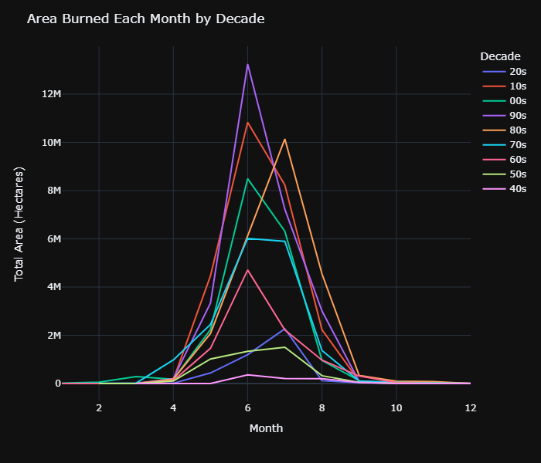
Findings
75% of fires were ≤ 1 hectare
Map of locations with multiple fires over 200 hectares
Notes:
So what did I Find?
Most fires are under 1 hectare, but the biggest ones consumed hundreds of thousands of hectares.
Map of locations that have had multiple fires
Seasonal trends.

Slide 7
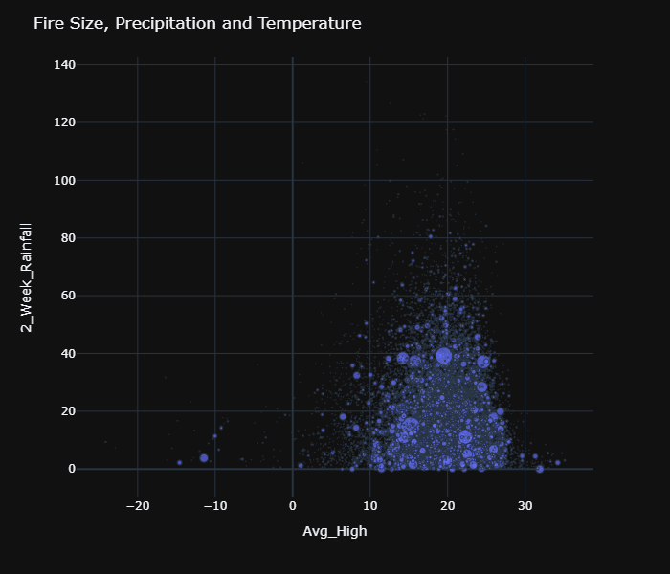
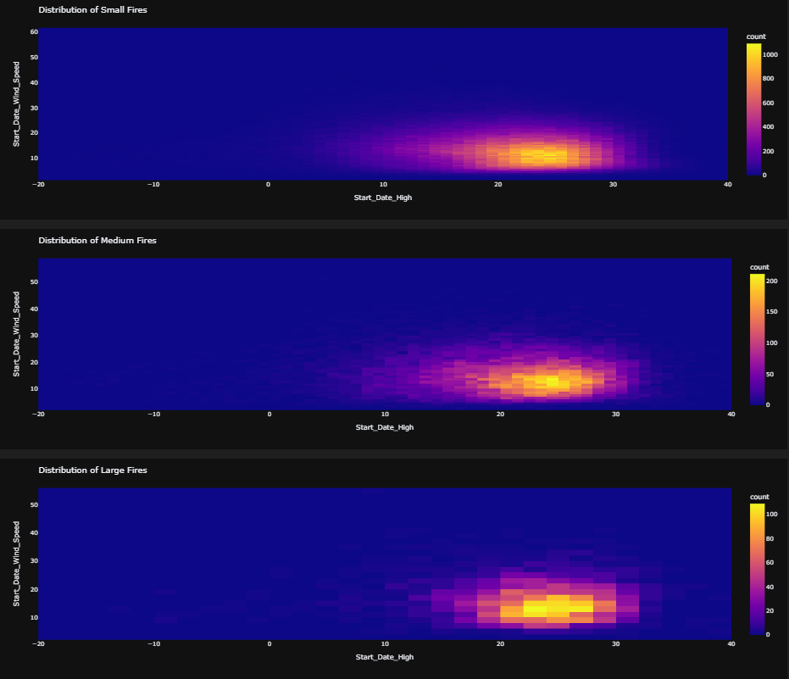
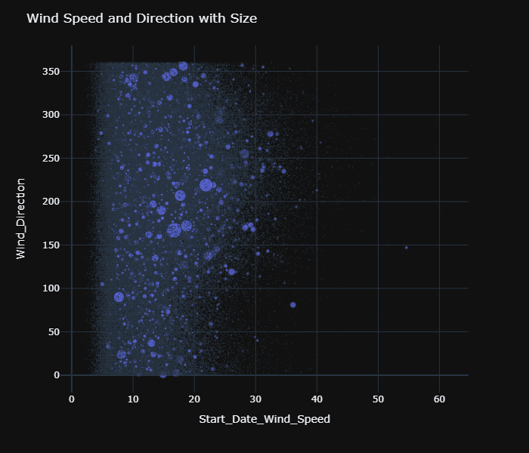
Notes:
Bringing in the weather data I looked for correlations with temperatures, rainfall or wind and fire size.
Best way to explore all this is through my dashboard.

Slide 8
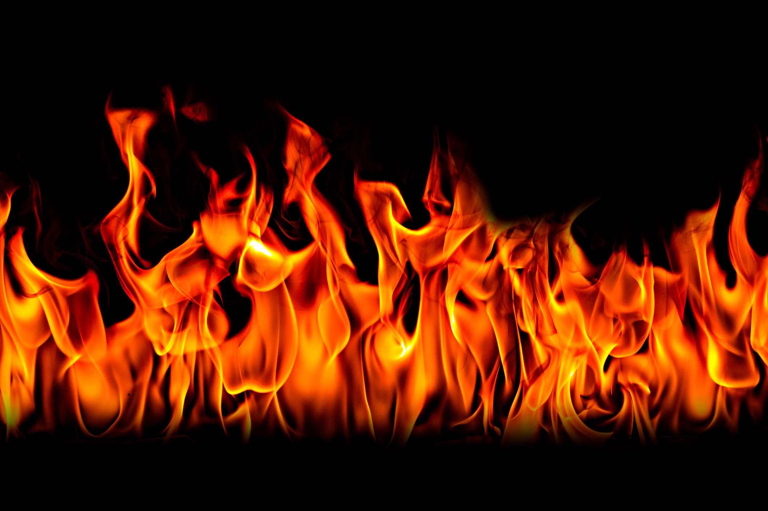
Predictive Models
Model | RMSE | R²
Small Fires | 1.970 | .102
Medium Fires | 888.0 | .087
Large Fires | 4,9176 | .012
Random Forest Classifier for fire size category
XGBoost Regressors for each category
Notes:
Started with just one regressor. Because of extreme skew, switched to first using a classifier to predict small, medium or large fires, then trained regressors for each size category.
Did not find a strong correlation between the weather and fire size.

Slide 9
Challenges
Future Work
Very skewed dataset
Weather was time consuming to pull
Not much of a correlation between the weather and fire data
Look for other data to pull into models
Fire Prevention Actions
Budgets
Distance to nearest population center
Longer-term weather data

Slide 10
Thank you
Email: ben.marsh304@gmail.com
Tableau Dashboard: Canadian Wildfires Dashboard
GitHub: www.github.com/btmarsh6/Canadian_Wildfires
LinkedIn: https://www.linkedin.com/in/ben-marsh304/

